Slide 1
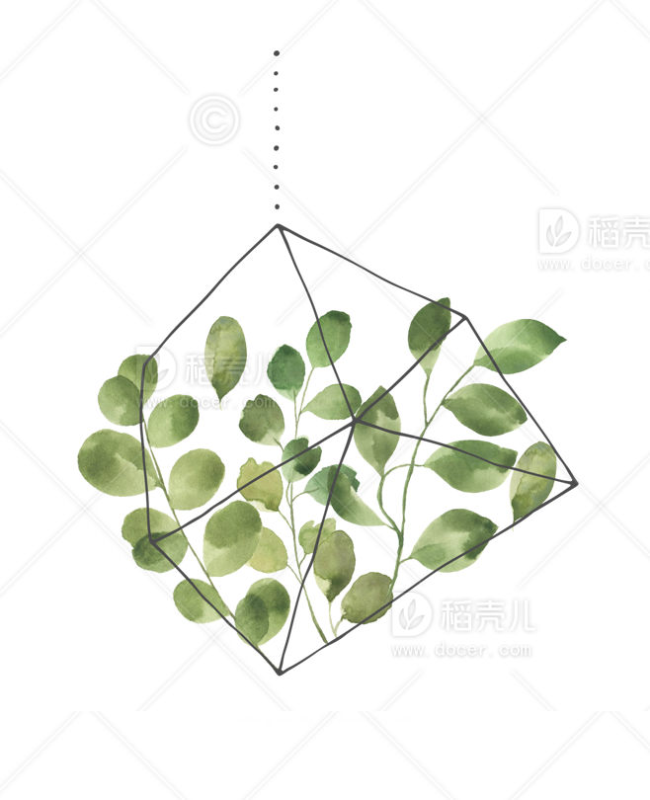
Coral Reef Classification

Slide 2
Hypothesis
Coral Reef’s Role
But they are bleaching
Coral Reef’s Classification
.Contribute to ecosystem
.Coastal protection for most tropical islands
.Provide habitat for biological diversity
.Know which area is in bad situation
.Take action to reduce polution
.Cryopreserving and reviving pieces of adult coral*
https://www.smithsonianmag.com/smithsonian-institution/scientists-cryopreserve-and-revive-coral-fragments-in-a-world-first-for-conservation-180982792/

Slide 3


CNNs Model Result

Slide 4
Two different datasets
One-shot Learning
.Transfer Learning
.Real world data - noise
.
.Allows the model to generalize from few examples
.Object classification algorithm that assesses the similarity and difference between two images

Slide 5
THANKS

